Slide 1
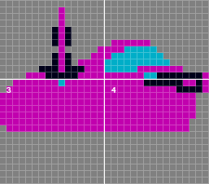

Solution 1: Sprite Threads

Slide 2
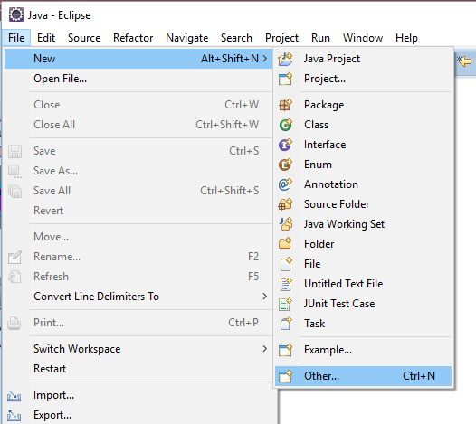
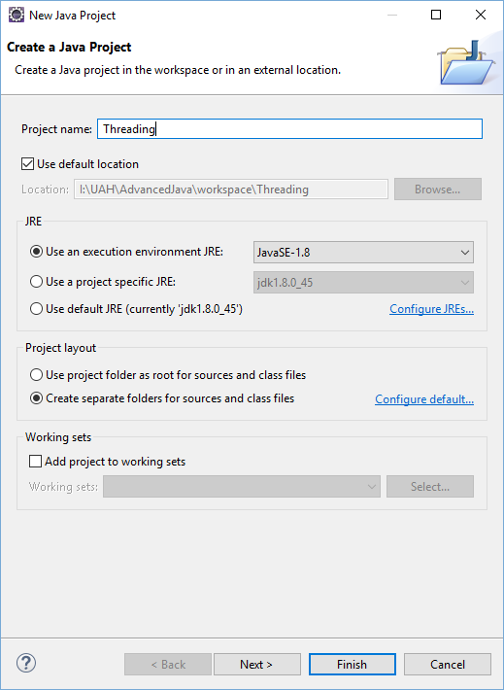
Step 1: Create a Project

Slide 3
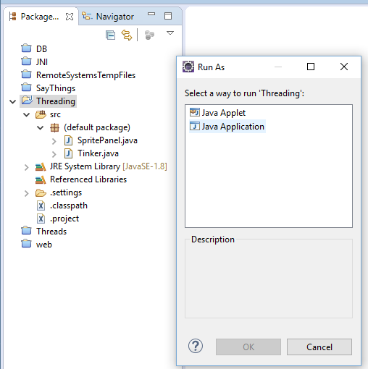
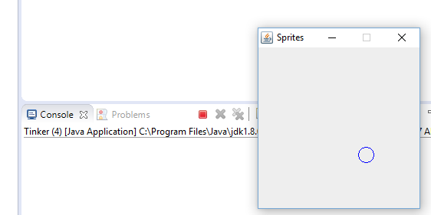
Step 1: Create a Project

Slide 4
LinePath
public class LinePath implements Runnable {
SpritePanel sp;
@Override
public void run() {
int x=10;
int y=10;
while(true) {
for(int c=0;c<100;++c) {
sp.updateMySprite(x, y);
x=x+1;
y=y+1;
try {
Thread.sleep(10);
} catch (InterruptedException e) {
e.printStackTrace();
}
}
for(int c=0;c<100;++c) {
sp.updateMySprite(x, y);
x=x-1;
y=y-1;
try {
Thread.sleep(10);
} catch (InterruptedException e) {
e.printStackTrace();
}
}
}
}
}

Slide 5
LinePath
public class Tinker {
public static void main(String [] args) {
// Create the sprite panel
SpritePanel sp = new SpritePanel();
// Put the panel on the screen
sp.putPanelInAFrame();
LinePath lp = new LinePath();
lp.sp = sp;
Thread t = new Thread(lp);
t.start();
}
}

Slide 6
SquarePath
public class SquarePath implements Runnable {
SpritePanel sp;
@Override
public void run() {
int x=5;
int y=5;
while(true) {
for(int c=0;c<100;++c) {
sp.updateMySprite(x, y);
x=x+1;
try {
Thread.sleep(10);
} catch (InterruptedException e) {
e.printStackTrace();
}
}
...

Slide 7
CirclePath
double r = 25.0;
while(true) {
for(double angle=0; angle<=2*Math.PI; angle=angle+Math.PI/36.0) {
double x = r * Math.cos(angle);
double y = r * Math.sin(angle);
sp.updateMySprite((int)(x+50), (int)(y+50));
try {
synchronized(this) {
this.wait();
}
} catch (InterruptedException e) {
e.printStackTrace();
}
}
}

Slide 8
Wait/Notify
double r = 25.0;
while(true) {
for(double angle=0; angle<=2*Math.PI; angle=angle+Math.PI/36.0) {
double x = r * Math.cos(angle);
double y = r * Math.sin(angle);
sp.updateMySprite((int)(x+50), (int)(y+50));
try {
synchronized(this) {
this.wait();
}
} catch (InterruptedException e) {
e.printStackTrace();
}
}
}
CirclePath p = new CirclePath();
p.sp = sp;
Thread t = new Thread(p);
t.start();
while(true) {
synchronized(p) {
p.notify();
}
try {
Thread.sleep(25);
} catch (InterruptedException e) {
e.printStackTrace();
}
}

Slide 9
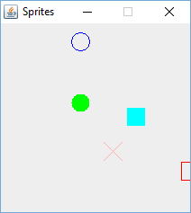
Lots of Threads
// Create the sprite panel
SpritePanel sp = new SpritePanel();
// Put the panel on the screen
sp.putPanelInAFrame();
LinePath lp1 = new LinePath(sp,10,10,75,50,1,0);
LinePath lp2 = new LinePath(sp,75,75,75,10,0,-1);
LinePath lp3 = new LinePath(sp,10,10,75,50,1,1);
Thread t1 = new Thread(lp1);
Thread t2 = new Thread(lp2);
Thread t3 = new Thread(lp3);
t1.start();
t2.start();
t3.start();
SquarePath sp1 = new SquarePath();
sp1.sp = sp;
Thread t4 = new Thread(sp1);
t4.start();

